Slide 1


Training Test for IT
http://schoolacademy.telerik.com
Preparation for IT Olympics
Team “Virginia Woolf”
НОИТ – ИТ тест
Telerik Software Academy
academy.telerik.com

Slide 2
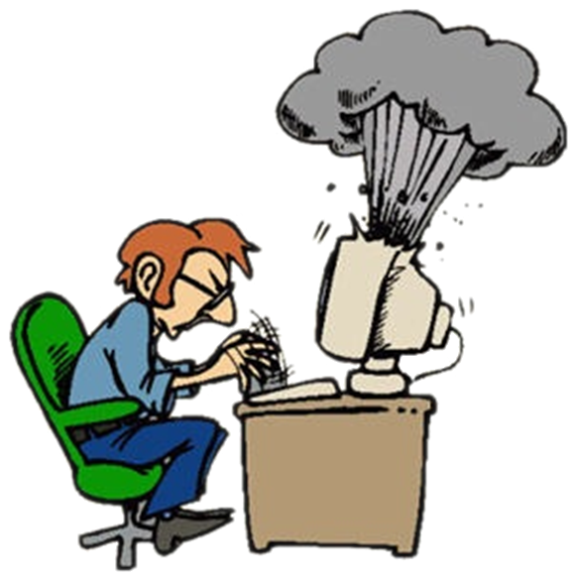

Computer systems
(hardware)

Slide 3
Question
1. In computer hardware, what does SSD stand for?
Super Speed Drive
Slow System Desktop
Solid State Drive
Safe System Diagnostics

Slide 4
Answer
The SSD is a data storage device with no moving mechanical components, making it quiet and more resistant to physical stress. Compared to HDDs it has a much lower access time and latency.
http://en.wikipedia.org/wiki/Solid-state_drive

Slide 5



Computer programs
(software)

Slide 6
Question
2. Which of the following is True for Vaporware ?
Software or product that is announced to the general public but is never actually released or officially cancelled.
Software that reminds the user to register it by paying a fee.
Software or product, for which no support is available.
Software used to gain access to private computer systems.

Slide 7
Answer
Vaporware is a term that describes a product, typically computer hardware or software, that is announced to the general public but is never actually released or officially cancelled.
http://en.wikipedia.org/wiki/Vaporware

Slide 8


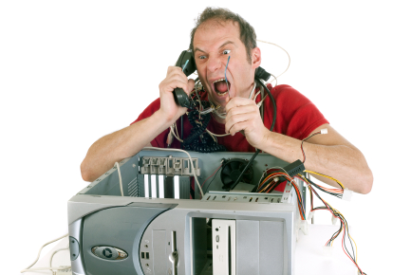
Rules for working with and supporting computer systems
Installing, Using, Support, …

Slide 9
Question
3. What is ACL – Access control list
lists of users and groups, with their specific permissions
lists of files in the system where everything has a label
lists of system objects such as directories and devices with discretionary access control
lists of files or objects imported from other systems

Slide 10
Answer
Access control lists (ACLs) are lists of users and groups, with their specific permissions.
They offer a more flexible way of providing discretionary access control. ACLs are implemented differently on different systems.
Link:
http://oreilly.com/catalog/csb/chapter/ch03.html

Slide 11

Means of data transfer in IT, Numeral systems
Channels for data transmission, measurement units, work with numeral systems

Slide 12
Question
4. What is Most significant bit (MSB)?
The most right bit in a binary number that represents if the number is positive or negative.
It’s an imaginary bit that can be counted when converting from one numeral system to another.
It is the highest bit in a series of numbers in binary, located at the far left of a string.
The most important bit in a number, without which the computer cannot read the number.

Slide 13
Answer
The MSB can also correspond to the sign bit of a signed binary number, "1" meaning negative and “0" meaning positive.
http://en.wikipedia.org/wiki/Most_significant_bit

Slide 14














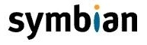
Operational Systems
Architecture, processes, users, user interface, file systems

Slide 15
Answer
Question
5. Which is not a state of a process?
Ready
Prioritized
Blocked
Running
Ready/ Waiting, Running, and Blocked are main states of a process in the OS.
http://en.wikipedia.org/wiki/Process_state

Slide 16

Software engineering and project development
Analysis, specification, design, prototype, implementation, testing, maintenance, ...

Slide 17
Question
6. The software engineering environment (SEE) consists of which of the following?
Customers
Hardware platforms
Software tools
Both b) and c)

Slide 18
Answer
Software engineering environment must consist hardware platform to operate on and IDE or Integrated Development Environment
An integrated development environment (IDE) also known as integrated design environment or integrated debugging environment is a software application that provides comprehensive facilities to computer programmers for software development.
Link:
http://en.wikibooks.org/wiki/Introduction_to_Software_Engineering/Print_version

Slide 19




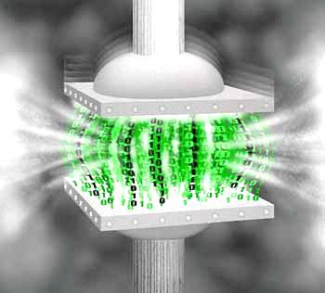




Compressing and decompressing data
Compression algorithms, backup software

Slide 20
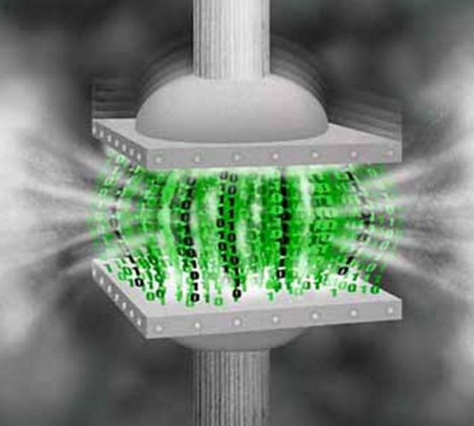
Question
7. Which of the following compression method is not lossless?
Run-length coding.
Dictionary coding.
Arithmetic coding.
Predictive coding.

Slide 21
Answer
In lossy predictive codecs, previous and/or subsequent decoded data is used to predict the current sound sample or image frame. The error between the predicted data and the real data, together with any extra information needed to reproduce the prediction, is then quantized and coded. In some systems the two techniques are combined, with transform codecs being used to compress the error signals generated by the predictive stage.
http://en.wikipedia.org/wiki/Lossy_compression

Slide 22



Text processing software and file formats
Working with word processing software, file formats, coding, text, tables, figures, ...

Slide 23
Question
8. Which one of the following image types does a RTF redactor NOT support:
PNG
WMF
BMP
JPG

Slide 24
Answer
RTF writers support JPG, PNG and WMF picture types. When a different image file is inserted (such as a BMP file), the software converts it to one of the supported types or does not insert the image at all. Some RTF readers, for the sake of better compatibility with Microsoft products, save two versions of the same file – one of them in an RTF supported file format (if the original is unsupported it gets converted to PNG or JPG) and one WMF (Windows MetaFile) which is included without any compression. This method, however, increases the file size immensely.
http://en.wikipedia.org/wiki/Rich_Text_Format

Slide 25
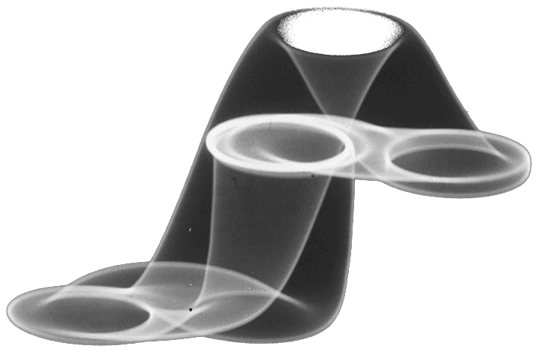



Computer graphics
Raster and vector graphics, graphic file formats, image editors, colors

Slide 26
Question
9. What is the RGB equivalent of the color red?
0,255,0
255,0,0
255,255,0
0,0,255

Slide 27
Answer
RGB Color Model is combination of three colors red, green and blue. Values of those colors can be in range from 0 to 255 ( 28 ). First range responds to the red color, second range responds to the green color, and third range responds to the blue color. When all of the values in the RGB model are 0s – the color is black, because there is no color at all. And when they are all equal to 255 it means the color is white.
http://www.w3schools.com/cssref/css_colors.asp
http://en.wikipedia.org/wiki/RGB_color_model

Slide 28




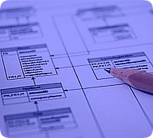

Databases
Data models, tables, relations, SQL

Slide 29
Question
10. Which one is not a function of a DBMS?
Creating and processing forms
Creating databases
SQL Processing
Administrating databases

Slide 30
Answer
DBMS is a collection of programs that enables user to create and maintain a database. In other words it is general-purpose software that provides the users with the processes of defining, constructing and manipulating the database for various applications.
http://en.wikipedia.org/wiki/Database

Slide 31

Information systems
ERP, CRM, BI, BPM, FMIS, CAD / CAM, CMS, software architectures

Slide 32
Question
11. What is the difference between Mb and MB?
MB is megabyte, Mb is megabit
Mb is Mega big, MB are initials
There is no difference.
MB is megabit, Mb is megabyte

Slide 33
Answer
There are 8 bits in a byte and bit is abbreviated with a lowercase, whereas byte - with an uppercase. This holds for Kb(KB), Mb(MB), Gb(GB),Tb(TB) etc. For example internet connection is measured in bits and data storage devices are measured in bytes.
http://en.wikipedia.org/wiki/Megabit
http://en.wikipedia.org/wiki/Megabyte

Slide 34


Security
Symmetrical and asymmetrical coding algorithms, cryptographic hash, digital signature, digital certificates

Slide 35

Question
12. Which of the following cryptographic algorithms is using different keys for encryption and decryption?
Blowfish
AES
RSA
None of the above

Slide 36
Answer
RSA is a cryptosystem, which is known as one of the first practicable public-key cryptosystems and is yet widely used for secure data transmission. The encryption key is public and differs from the decryption key which is kept secret.
http://en.wikipedia.org/wiki/RSA_%28cryptosystem%29

Slide 37




Presentation making & Presentation skills
Presentation software, preparation of presentations, slides, effects, notes, colors, images, sound, video

Slide 38
Question
13. Which of the techniques below is a technique for successful presentation?
Reading what is on the screen word by word
Displaying too much detail and lots of numbers
Using graphic elements (such as photos) to trigger memory about key points
Using the standard clipart that everyone uses

Slide 39
Answer
Using graphic elements (such as photos) to trigger memory about key points.
Example: if there are a few key points in the presentation, usage of a photo can be associated with each point. When an image is used on a slide as a visual mnemonic, the idea becomes clear, as well as the presentation, memorable.
http://office.microsoft.com/en-nz/powerpoint-help/10-tips-to-enhance-presentations-HA001188725.aspx

Slide 40
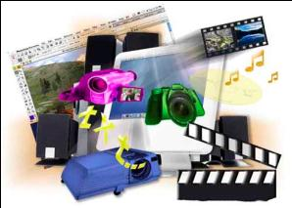

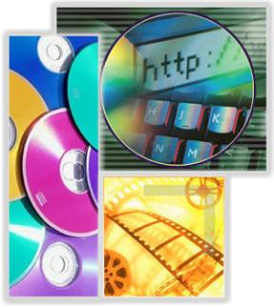

Multimedia
Software creation / processing media: audio, video, file formats

Slide 41
Question
14. Which of the following best describes the process of streaming?
Playing audio files
Delaying playing a multimedia element until enough data has been buffered so the element can play uninterrupted
Reducing the load time of a Web page by streamlining operations
Sending packets to a Web server so improve server performance

Slide 42
Answer
Useful - and typical - applications of the "streaming" concept are, for example, long video lectures performed "online" on the Internet. An advantage of this presentation is that these lectures can be very long, indeed, although they can always be interrupted or repeated at arbitrary places.
http://en.wikipedia.org/wiki/Stream_processing
http://en.wikipedia.org/wiki/Streaming_media

Slide 43


Computer networks
OSI model, network models, protocols, standards, hardware

Slide 44
Question
15. Which of the IP addresses are public?
10.10.10.10
192.168.168.168
4.2.2.2
172.16.16.16

Slide 45
Answer
4.2.2.2 is a valid public IP address. It is actually a well-known DNS server which is ping-able and is often used by network admins to test Level 3 connectivity.
http://en.wikipedia.org/wiki/IP_address

Slide 46



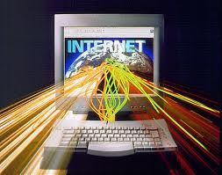
Internet
Internet, protocols, services, WWW, HTTP, FTP, SMTP, POP3, IMAP, WebDAV, IP, DNS

Slide 47
Question
16. Which of the following can be used to access the Internet?
PoP3
SMTP
ICQ
ISDN

Slide 48
Answer
ISDN (Integrated Services Digital Network) is a set of protocols for establishing and break of distinct channels for dial-up connections. In some countries, ISDN is mainly used for Internet access, the maximum speed that is possible is 128 kbit / sec.
http://en.wikipedia.org/wiki/Integrated_Services_Digital_Network

Slide 49





Electronic communication and e-mail
E-mail, Skype, ICQ, IRC, MSN Messenger, Yahoo Messenger, social networks, forums, ...

Slide 50
Question
17. What does the term MIME stand for?
Mail Internet Mail Exchange
Mail Interleave Method Exchange
Multipurpose Internet Mail Extensions
Multipurpose Interleave Mail Exchange

Slide 51
Answer
Short for Multipurpose Internet Mail Extensions, MIME is a standard format first defined in 1992 that allows the attachment and sending of non-text files, such as compressed file, sound file, graphic file, document file, video file, and various other files in an e-mail message.
http://en.wikipedia.org/wiki/MIME

Slide 52




World Wide Web (WWW)
How does WWW? Protocol HTTP, GET, POST, URL, web browser, web page, web site ...

Slide 53
Question
18. Which of the following browsers supports the E-mail protocol?
Google Chrome
Internet Explorer
Mozilla Firefox
Opera

Slide 54
Answer
Most browsers avoid supporting this protocol within themselves, as this is reserved for their according e-mail clients. Google Chrome has Gmail Offline, Internet Explorer has Microsoft Outlook, Mozilla Firefox has Mozilla Thunderbird. Opera also has an e-mail client which you can download, called Opera Mail, but it also has an inbuilt e-mail support in the browser itself.
http://en.wikipedia.org/wiki/Comparison_of_web_browsers

Slide 55




Web Front-end and Design
Web Design, HTML, CSS, text, graphics, links, tables, forms

Slide 56
Question
19. Which of the following is correct?
<img location=”” />
<img src = “” alt=”” />
< image src=”” alt=””></image>
<img src=”” alt=””></img>

Slide 57
Answer
The tag is <img> not <image> or <picture>. It has a mandatory property src=”” which provides info for the location of the image. ‘src’ stands for source. The property alt=”” is recommended but not required and it shows a text when the image can’t be loaded. Also the closing tag is contained within the opening one.
http://en.wikipedia.org/wiki/HTML
http://host.bg/bg/info/Struktura-na-HTML-dokument

Slide 58





Web scripting languages (JavaScript, Perl, etc.)
Development of scripts with JavaScript, basic JavaScript constructs, operators, objects, manipulation of DOM tree

Slide 59
Question
20. JavaScript is ...?
A client-side scripting language
A server-side scripting-language
A virus
another name for Java

Slide 60
Answer
JavaScript is a client-side scripting language that is run from within your browser instead of from a server. Using JavaScript a developer can add features that are not available through HTML without having to rely on a server-side language like PHP.
http://en.wikipedia.org/wiki/JavaScript

Slide 61
Exercise test in Information Technologies
?
?
?
?
?
?
?
?
?
Questions?
?
?
?
?
?
?
?
?
?
?
http://schoolacademy.telerik.com

